Slide 1
CSD 3423
Project Management
Lesson 2

Slide 2
Lesson 2 Learning Outcomes
Apply the project management knowledge areas, process groups, and traditional methods to IT projects
2.1 Classify the five project management process groups
2.2 Map the process groups to the knowledge areas
2.3 Identify the unique attributes of IT projects (versus non-IT projects)
2.4 Develop and Demonstrate a waterfall project management methodology for IT projects

Slide 3
Project Management Purpose
“Project management is the application of knowledge, skills, tools and techniques to project activities to meet the project requirements: Project management is accomplished through the appropriate application and integration of the 49 logically grouped project management processes comprising the five Process Groups.”
Notes:
The purposes of doing projects and managing projects are quite different. We do projects to create change; to take us from here to there. We manage projects to ensure that the change is implemented with effectiveness and efficiency.
Many organizations do projects, but how do they manage them. Perhaps a Gantt chart is used to illustrate a schedule. Often, the person most involved with the functional aspects of the project is expected to do the work and manage the project, with limited management training or support.
What do we mean when we say that the purpose of project management is to get work to flow vertically as well as horizontally within the organization? Vertical refers to the traditional or functional organizational structure. Projects are usually, cross functional in nature, requiring the integration of work of several departments in order to achieve success. Horizontal work flow means moving the work and decision making across an organization at the level of those accountable for the work, rather than up one silo to the executive, across to the next silo then back down to the resource managers. The effect of project management is to increase effectiveness by empower managers and move decision making to lowers levels in the organization.

Slide 4
2.1 Project Management Process Groups
Initiating
Planning
Executing
Monitoring and Controlling
Closing

Slide 5
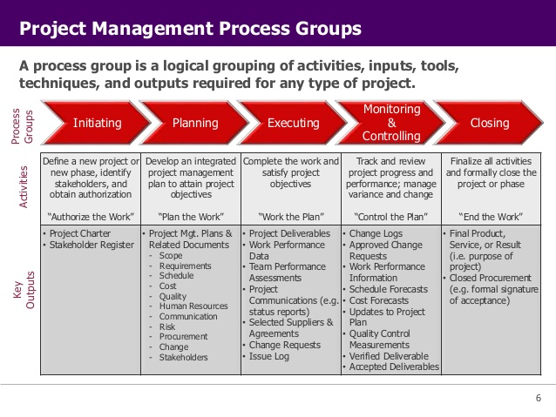

Slide 6
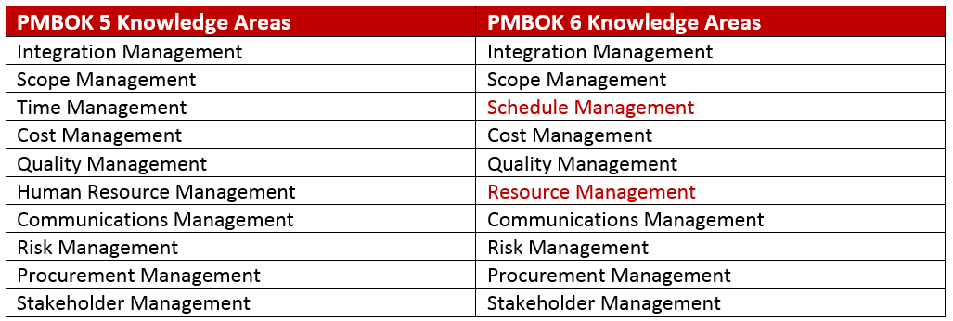

Slide 7
PM Knowledge Areas
• Integration management— processes and activities needed to define, combine, unify, and coordinate the various processes and project management activities
• Scope management— processes required to ensure that the project includes all the work required, and only the work required, to complete the project successfully
• Project Schedule management— processes required to manage timely completion of the project
• Cost management— processes involved in estimating, budgeting, and controlling costs so that the project can be completed within the approved budget
PMBOK 6th Ed.

Slide 8
PM Knowledge Areas…..
• Quality management— processes and activities of the performing organization that determine quality policies, objectives, and responsibilities so that the project will satisfy the needs for which it was undertaken
• Project resource management— processes that organize, manage, and lead the project team
• Communications management— processes required to ensure timely and appropriate generation, collection, distribution, storage, retrieval, and ultimate disposition of project information
PMBOK 6th Ed.

Slide 9
PM Knowledge Areas…..
• Risk management— processes of conducting risk management planning, response planning, and monitoring and control … to increase the probability and impact of positive events and decrease the probability and impact of negative events in the project
• Procurement management— processes necessary to purchase or acquire products, services, or results from outside the project team
• Stakeholder Management — includes the processes required to identify, analyze and devise engagement strategy of the people, groups, or organizations that could impact or be impacted by the project
PMBOK 6th Ed.

Slide 10
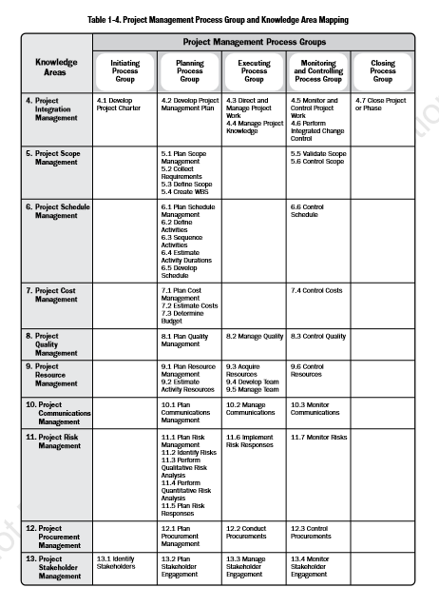

Slide 11
Project Management (PM)
Project management – “the application of knowledge, skills, tools and techniques to project activities to meet project requirements.” PMBOK® Guide
Work processes that work.
Tradeoffs among
initiate
plan
execute
monitor and control
close
Scope Schedule
Quality Resources
Cost Risks
Notes:
PM includes work processes that initiate, plan, execute, and close work
Work processes require tradeoffs among the scope, quality, cost, and schedule of the project
PM includes administrative tasks for planning, documenting, and controlling work
PM includes leadership tasks for visioning, motivating, and promoting work associates.
PM knowledge, skills, and methods apply for most projects

Slide 12
Project Management (PM)
planning documenting controlling
Administrative tasks
Leadership tasks for work associates
Knowledge, skills, and methods apply for most projects
visioning motivating promoting
Notes:
PM includes administrative tasks for planning, documenting, and controlling work
PM includes leadership tasks for visioning, motivating, and promoting work associates.
PM knowledge, skills, and methods apply for most projects

Slide 13
Benefits to Organization
Organizational focus – strategy turned into action
Prioritization – staff knows what is important
Visibility – manager can see where things are
Better resource use – less wasted effort and time
Process improvement – great application of PM
Improved communication – defined approaches/tools
Measurable results – quantifiable objectives
Documentation available – avoids lost knowledge

Slide 14
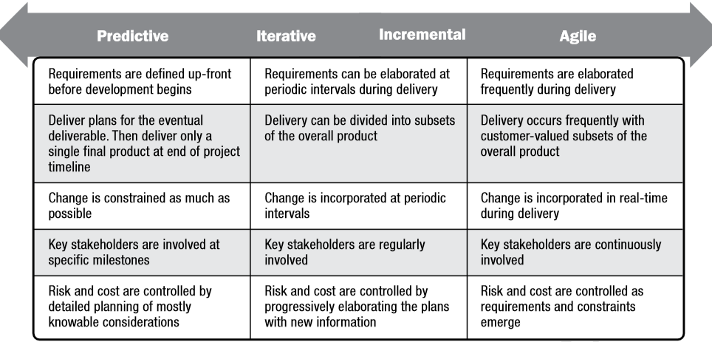
2.3 Various Method of Conducting IT Project

Slide 15




2.4 Project Management Methodologies
In waterfall life cycle, the scope is defined at the beginning of the project
In agile life cycle the scope is developed progressively over many interations
Baselined
Ongoing
Predictive life cycles
Adaptive/Agile life cycles
The Scope is baselined and can only be changed through formal change control
Are intended to respond well to high amount/level of changes
The contribution of the sakeholders/sponsor it is before the baseline
Require continuos stakeholders/sponsor engagement
Requirements are collected, scope is defined, and WBS is created once during the planning phase
The processes of Collecting Requirements, Defining Scope, and Creating WBS are repeated during agile projects
The Scope Baseline is used during the Monitoring and Controlling phase to prevent ‘scope creep’
This processes are performed since the beginning and updated as needed using the integrated change control process
The process of Validating Scope is performed at the end of each deliverable phase
The process of Validating and Controlling Scope are repeated for each interaction

